Slide 1
Mentor Task
Weather Forecast

Slide 2
Steps to get weather
Detect user’s geographical location
Fetch capital weather
Fetch all cities within this Country
Fetch Image for every State from wikipedia

Slide 3
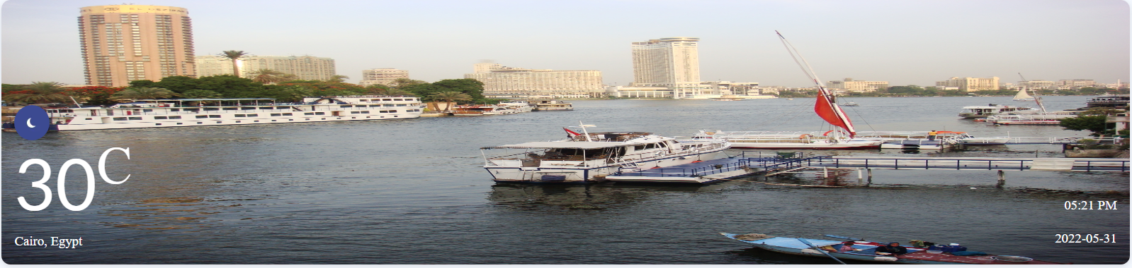
Check the temperature now.
Show temperature, location(city/country),current date time and status
Note: default photo of city is fetched from Wikipedia

Slide 4
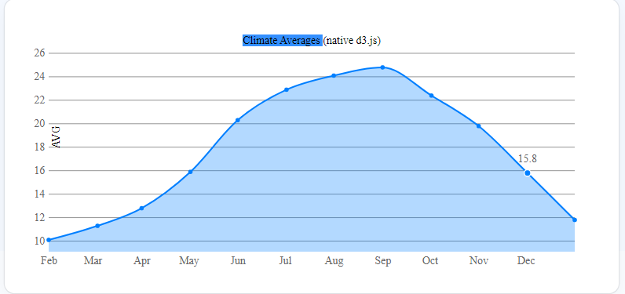
Climate Averages(history data)
Drawing using native d3.js library
Y axis represent average temperature for every month
X axis represent month name

Slide 5
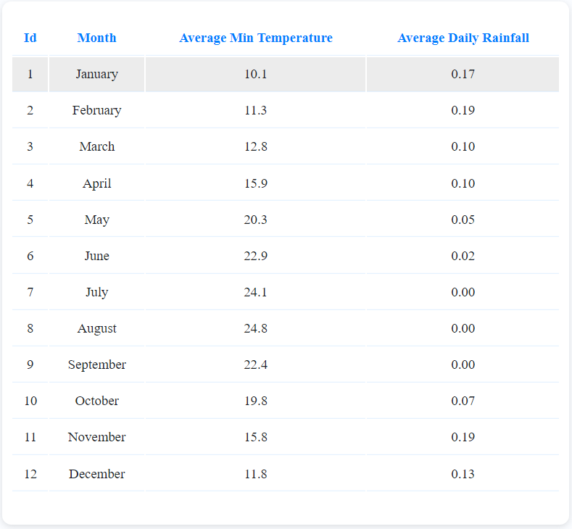
Climate Averages(history data)
Also you can see full details in table

Slide 6
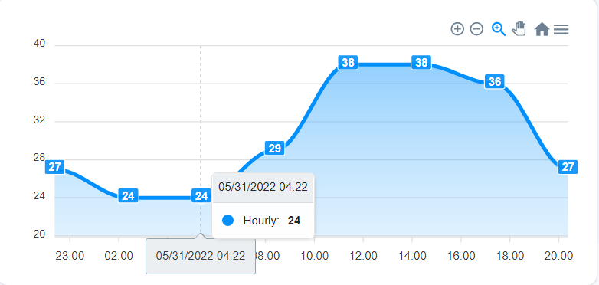
hourly weather
View temp in every hour in current day
Y axis represents temp, X axis represents hour

Slide 7
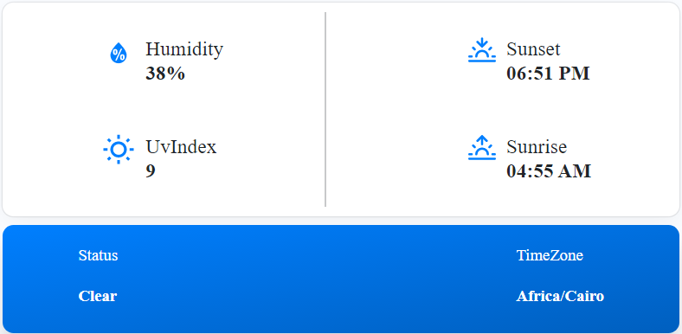
More Details About Weather

Slide 8
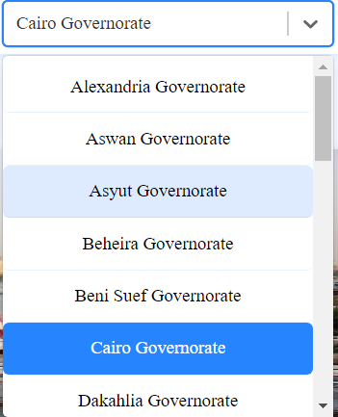
Search Or Select State
By default we Will Select Capital of your Country

